Slide 1
Interest Rate Derivatives Pricing

Slide 2
Pricing IR derivatives Quick Introduction

Slide 3
Pricing: process
Select market instruments to build an IR Curve
Extract Zero Coupon Risk Free Rates from the curve previously built
Pricing:
If the product could be rebuilt with a combination of Zero Coupon Bond (ex: standard swap with strike at swap rate + m bps), then the product price will be the linear combination of the ZC prices
If the product is more complex, depending on the future value of the yield curve, the choice and use of a model to projection the yield curve is necessary. For instance:
Vasicek / CIR
HJM consistent model
BGM model
Use this model to compute a Closed-Form Formula or to compute the price with numerical methods like Monte Carlo algorithms or PDEs

Slide 4
Basics

Slide 5
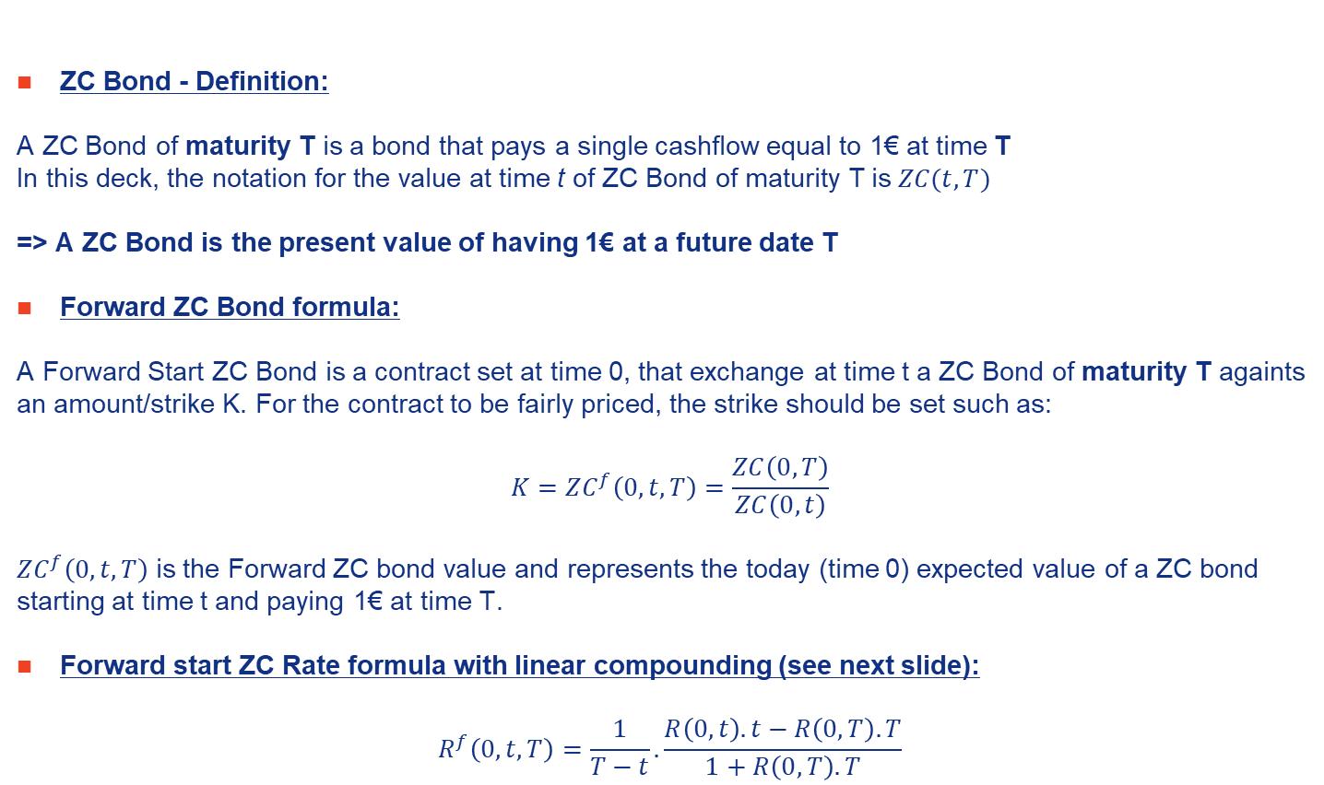
Zero Coupon (ZC) Bonds
ZC Bond - Definition:
A ZC Bond of maturity T is a bond that pays a single cashflow equal to 1€ at time T
In this deck, the notation for the value at time t of ZC Bond of maturity T is $ZC(t,T)$
=> A ZC Bond is the present value of having 1€ at a future date T
Forward ZC Bond formula:
A Forward Start ZC Bond is a contract set at time 0, that exchange at time t a ZC Bond of maturity T againts an amount/strike K. For the contract to be fairly priced, the strike should be set such as:
$$K=ZC^{f}\left(0,t,T\right)=\frac{ZC\left(0,T\right)}{ZC\left(0,t\right)}$$
$ZC^{f}\left(0,t,T\right)$ is the Forward ZC bond value and represents the today (time 0) expected value of a ZC bond starting at time t and paying 1€ at time T.
Forward start ZC Rate formula with linear compounding (see next slide):
$$R^{f}\left(0,t,T\right)=\frac{1}{T−t}.\frac{R\left(0,t\right).t−R\left(0,T\right).T}{1+R\left(0,T\right).T}$$

Slide 6

1€
ZC Bond (buyer position)
t=0
t=T
ZC(0,T)
Forward Start ZC Bond (receiver position)
Receive ZC(t,T) for a price K
1€
t=0
t
Time of settlement
t=T
K
>How to set K such as the value of the deal is fair at settlement date (t=0)?

Slide 7
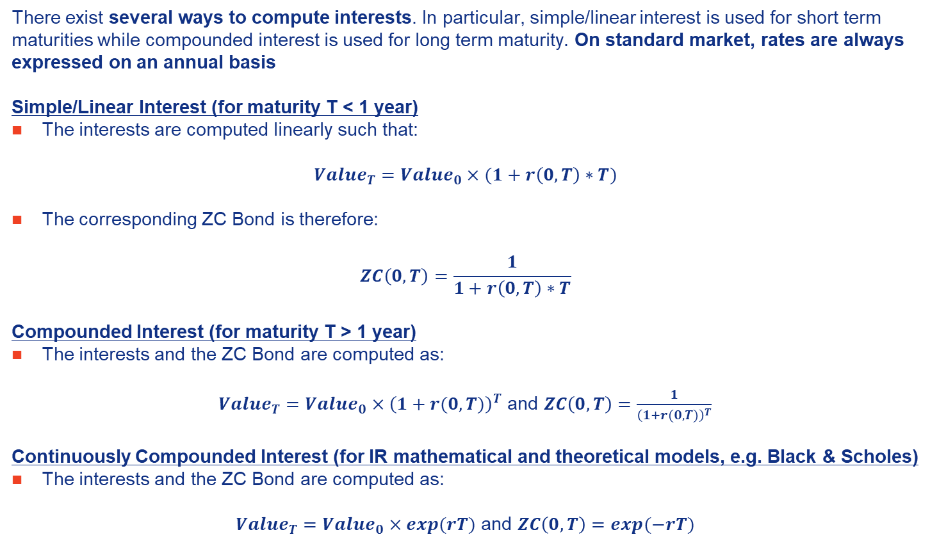
Interest Rate Interests Computation
There exist several ways to compute interests. In particular, simple/linear interest is used for short term maturities while compounded interest is used for long term maturity. On standard market, rates are always expressed on an annual basis
Simple/Linear Interest (for maturity T < 1 year)
The interests are computed linearly such that:
$$Value_{T}=Value_{0}×(1+r\left(0,T\right)∗T)$$
The corresponding ZC Bond is therefore:
$$ZC\left(0,T\right)=\frac{1}{1+r\left(0,T\right)∗T}$$
Compounded Interest (for maturity T > 1 year)
The interests and the ZC Bond are computed as:
$Value_{T}=Value_{0}×{\left(1+r(0,T)\right)}^{T}$ and $ZC\left(0,T\right)=\frac{1}{{\left(1+r(0,T)\right)}^{T}}$
Continuously Compounded Interest (for IR mathematical and theoretical models, e.g. Black & Scholes)
The interests and the ZC Bond are computed as:
$Value_{T}=Value_{0}×exp(rT)$ and $ZC\left(0,T\right)=exp(−rT)$

Slide 8
IR Curves and Markets

Slide 9
Interest rate curves & markets
An interest rate curve (or term structure of interest rate) is the function mapping each maturity to the interest rate of the same maturity
At a given date, in a given country (or in a common-currency area), there exist several interest rate curves. For instance, in the Euro zone, IR curves of Germany, France and PIIGS are different.
3 main «Markets» for IR curve:
Sovereign or Government curves
Corporate curves
Interbank curves
On each of those Markets, there are :
Market curves : directly built from quotations of market instruments like Sovereign Bonds or Swaps
Implied curves : constructed from market quotations, transforming quotations by applying more or less complex formulas

Slide 10
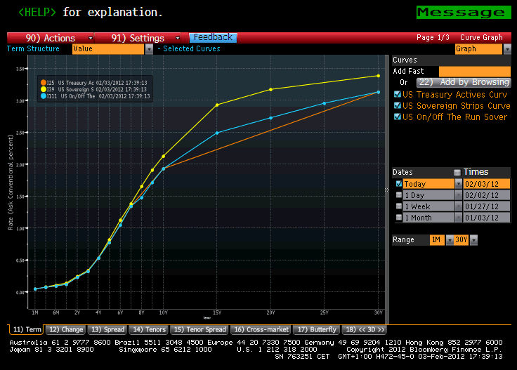
US Zero-Coupon rates vs. Yield-to-Maturity

Slide 11
Some general comments about rate markets
Examples of market curves:
YTM
Swap rates
Libor/Euribor rates
Future rates
Examples of implied curves:
Zero-Coupon rates
Par rates
Forward rates
« Instantaneous » forward rates

Slide 12
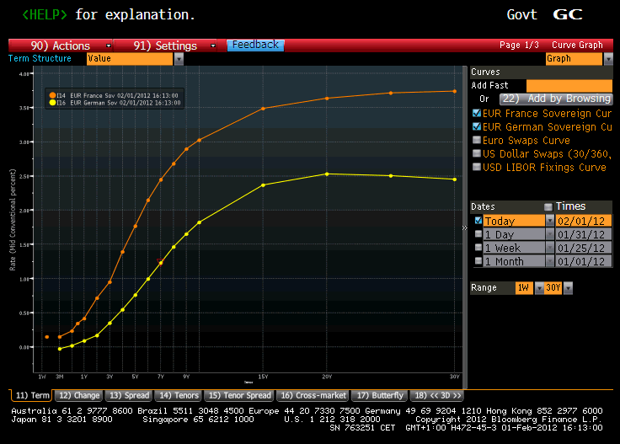
Yield-To-Maturity rates (Germany vs. France)

Slide 13
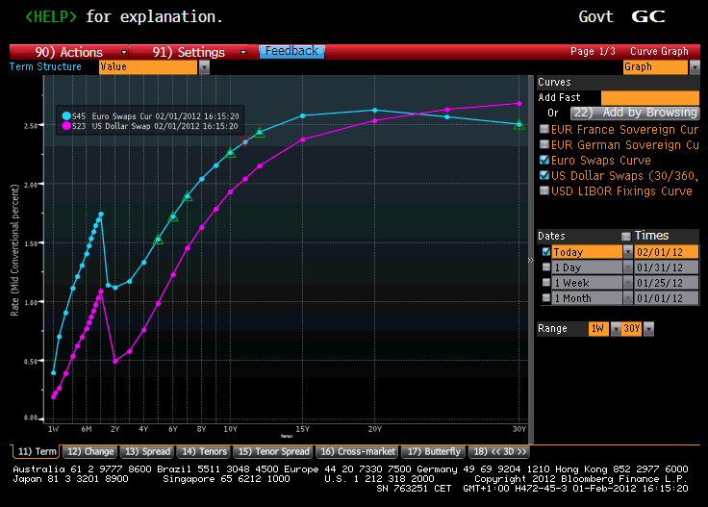
Euro and US Swap Curves

Slide 14
Interbank Market (Libor, Euribor,…)

Slide 15
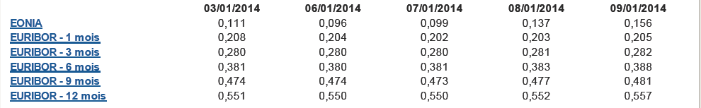
Interbank Market Interbank rate: Euribor & Eonia/€STR for EUR currency
EONIA (Euro OverNight Index Average)/€STR and Euribor (Euro Interbank Offered Rate) are short term interest rate indices with maturity < 1 year
16 maturities are available:
1 overnight => EONIA/€STR index
15 Euribor Maturities: 1W, 2W, 3W and 1M to 12M
Day Count convention is Exact / 360
Rate are linearly compounded
Remarks/Precisions: 1) EONIA/€STR is computed as the weighted average of all overnight unsecured lending transactions observed in the EUR Market 2) Euribor is computed on a daily basis as the average of real transactions observed on a EUR bank panel for unsecured fund lending 3) A 2-day lag has to be observed to enter in a loan/lend transaction in the EUR market
Illustration (data from Central Bank of France): www.banque-france.fr/economie-et-statistiques/changes-et-taux/les-taux-interbancaires.html

Slide 16
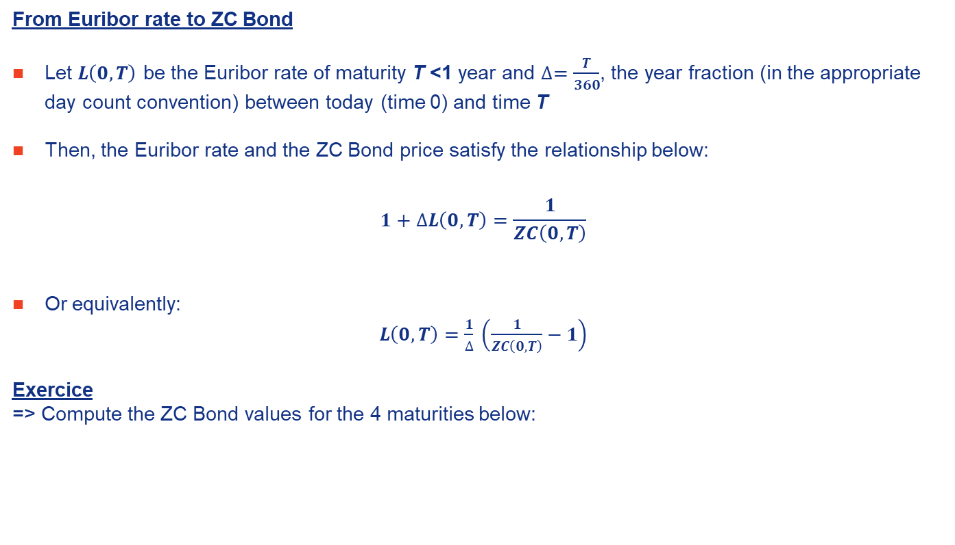
Interbank Market Interbank rate: Euribor & Eonia for EUR currency
From Euribor rate to ZC Bond
Let $L\left(0,T\right)$ be the Euribor rate of maturity T <1 year and $∆=\frac{T}{360}$, the year fraction (in the appropriate day count convention) between today (time 0) and time T
Then, the Euribor rate and the ZC Bond price satisfy the relationship below:
$$1+∆L\left(0,T\right)=\frac{1}{ZC\left(0,T\right)}$$
Or equivalently:
$L\left(0,T\right)=\frac{1}{∆} \left(\frac{1}{ZC\left(0,T\right)}−1\right)$
Exercice
=> Compute the ZC Bond values for the 4 maturities below:
Maturity | Euribor | Maturity in days
1M | 1,01% | 28
3M | 1,26% | 92
6M | 1,53% | 183
12M | 1,98% | 365

Slide 17
Swaps

Slide 18
Swaps - Introduction
Swaps are contracts characterized by exchanges of cash flows between 2 counterparties (without any capital exchange)
The cash flows are calculated over a notional (or principal) amount
The swap agreement defines the dates when the cash flows are to be paid
There exist several swap types:
Standard swaps
Amortizing swaps
Zero-coupon swaps
Forward start swaps
CMS (Constant Maturity Swap) swaps
Basis swaps
...
As a start, we will consider standard swaps (also denominated as “plain-vanilla swap”)

Slide 19
Swaps - Introduction (2)
What is a standard swap?
These swaps have the following specs:
Exchange of a fixed leg (payments depend on a fixed rate) against a floating leg (payments depend on a floating rate)
a constant notional amount during the lifetime of the swap.
a maturity of the floating rate equals to the time between 2 payments of the floating rate
Payer and Receiver swaps:
A swap is payer when the buyer pay the fixed leg
A swap is receiver when the buyer the floating leg
Remark: buy payer = sell receiver / buy receiver = sell payer

Slide 20
Swaps – Introduction (3)
Example:
Consider a Euribor 6 months payer swap of maturity 3 years at date 01/01/14, with a fixed rate set at K and of notional amount of 1,000,000 euros
Eur(t) is the value of the 6 months Euribor rate observed (or settled) at time t and paid at T+6 months (the cash flow is divided by 2 as the year fraction between t and t+6 months is approximately ½)
01/07/14 | 01/01/15 | 01/07/15 | 01/01/16 | 01/07/16 | 01/01/17
x | -1,000,000*K | x | -1,000,000*K | x | -1,000,000*K
-1,000,000* Eur(1 Jan, 1 July) / 2 | 1,000,000* Eur(1 July 14, 1 Jan 15) / 2 | 1,000,000* Eur(1 Jan 15, 1 July 2015) / 2 | 1,000,000* Eur(1 July 15, 1 Jan 16) / 2 | 1,000,000*Eur(t) / 2 | 1,000,000*Eur(t) / 2

Slide 22
Swaps – Introduction (4)
Every 6 months, the “buyer” of the payer swap will receive Euribor 6 months observed 6 months before, multiplied by the notional amount and the year fraction between the observation and the payment date (close to 0.5 is this case)
The “buyer” will pay every year a fixed rate K multiplied by the notional amount and the year fraction between the observation and the payment date (close to 1 is this case)
Naturally, the “seller” of the swap will receive the fixed rate and pay the floating rate

Slide 23
Terminology and conventions
Characteristics of a standard swap
Legal Framework: all swaps are traded under ISDA terms and conditions
Notional amount: Amount based on which the interest cash flows are computed (as a multiplier). This amount is the same for both legs
Example: Consider a swap exchanging 3 month Euribor vs. a 5% fixed rate. The notional amount is set at 100 million euros. In this case, the interest cash flows of the fixed leg (paid every year) is equal to 5 million euros (5 million = 100 million * 5%)

Slide 24
Terminology and conventions
Characteristics of a standard swap (2)
Basis: convention to compute the year fraction between 2 dates. The most commonly used basis is “Exact/360” which estimate that the year fraction between 2 dates is equal to the exact number of days between the 2 dates divided by 360. This day count convention is usually used for swaps in dollars and euros. The day count convention “Exact/365” is used for swaps pounds
Currency: currency in which the cash flows are exchanged
Maturity: Date at which the swap ends (date of the last interest cash flow).

Slide 25
Terminology and conventions
Characteristics of a standard swap (3)
Cash flow dates: Dates at which cash flows occur. Determined at inception of the contract
Frequency between 2 payments of the fixed leg is generally annual (euro) or semi-annual (US)
Frequency between 2 payments of the floating leg is equal to the maturity of the floating rate and is generally 3 or 6 months

Slide 26
Terminology and conventions
Characteristics of a standard swap (4)
Example: The payments of the floating leg of a 3 months Euribor swap occur every 3 months
If the buyer and the seller have to pay their respective leg at the same time, only the difference between them is exchanged
Floating rate: the floating rate - generally paid at the end of the period – is known at the beginning of the period. Then the first floating cash flow payment is known at inception of the contract
Fixed rate: the “Market Maker” compute the value of the fixed rate such that the value of the swap is zero at inception (no exchange of cash at inception). This also means that the market value of the fixed leg and the floating leg are equals. In that situation, the fixed rate is called the swap rate

Slide 27
Terminology and conventions
Characteristics of a standard swap (5)
Quotations: swaps are quoted in 2 ways
swap rate: the «market maker» quotes a bid/ask. “Bid” is the swap rate at which he is ready to pay the fixed leg when the “Ask“ corresponds to the swap rate at which he is ready to receive the fixed leg
swap spread: this is the difference between the swap rate of a given maturity T and the Yield-To-Maturity of a sovereign bond of the same maturity T. The swap spread is expressed in basis points (1 bp = 1% of 1%=1e-4)
The «market maker» also quotes a bid/ask for swap spread. For instance «45/50» means that the «market maker» is ready to pay the fixed leg 45 basis points above the YTM of the sovereign bond, and to pay the floating leg 50 basis points above the YTM of the sovereign bond

Slide 28
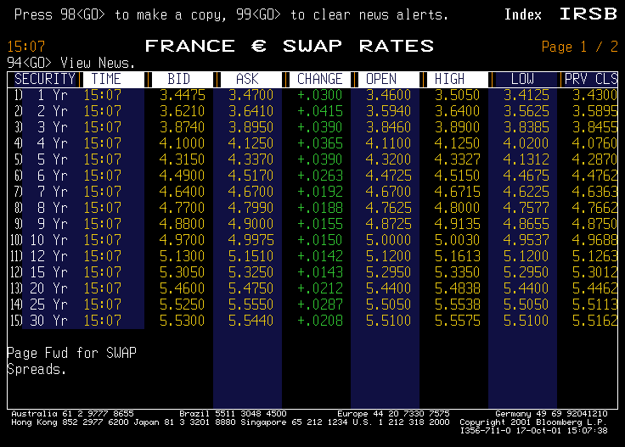
Quotations of swaps - Euro zone

Slide 29
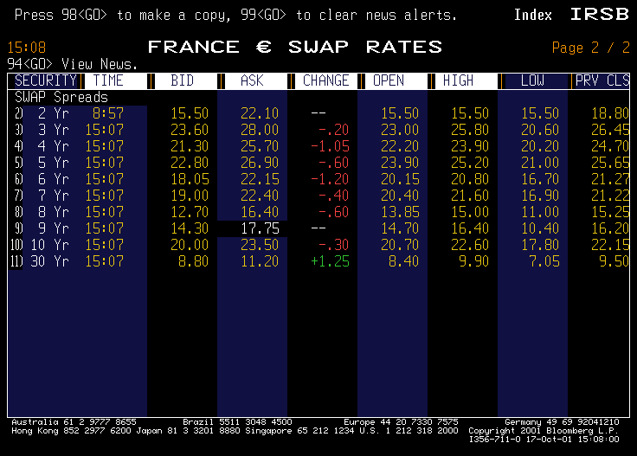
Quotations of swaps - Euro zone

Slide 30
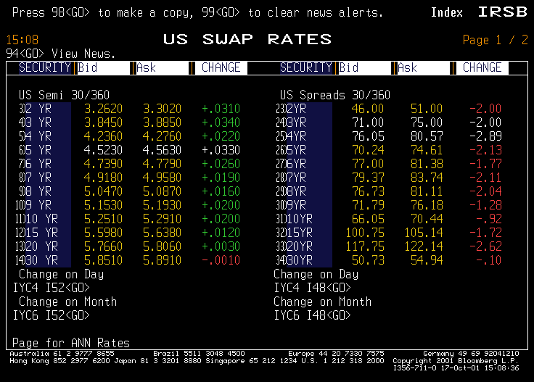
Quotations of swaps - US

Slide 31
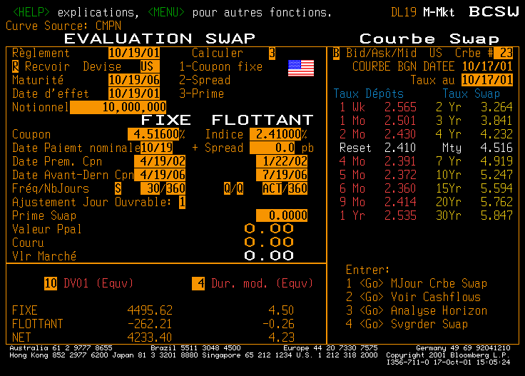
Quotations/Pricing of swaps: example

Slide 32
Uses and pricing of standard swaps
Swaps are used for the following reasons:
optimize/transform the nature of a debt
create new synthetic products
hedge interest rate risks
Swap pricing – classical market practice
This approach assumed that the future floating rates are equals to forward rates computed at pricing date
When maturity of the floating rate is equal to the frequency between 2 payments of the floating leg AND when the floating rate is paid at its natural date (its maturity) as it is the case for standard swap, this approach is valid
For other cases, an interest rate model is required to price the swap
Remark: at inception, the value of the swap is known and equal to 0. The formula we will present is useful to extract Zero-Coupon (or Discount Factors) from the swap rate curves and to help to price other IR derivatives (among them swaps issued in the pasts)

Slide 33
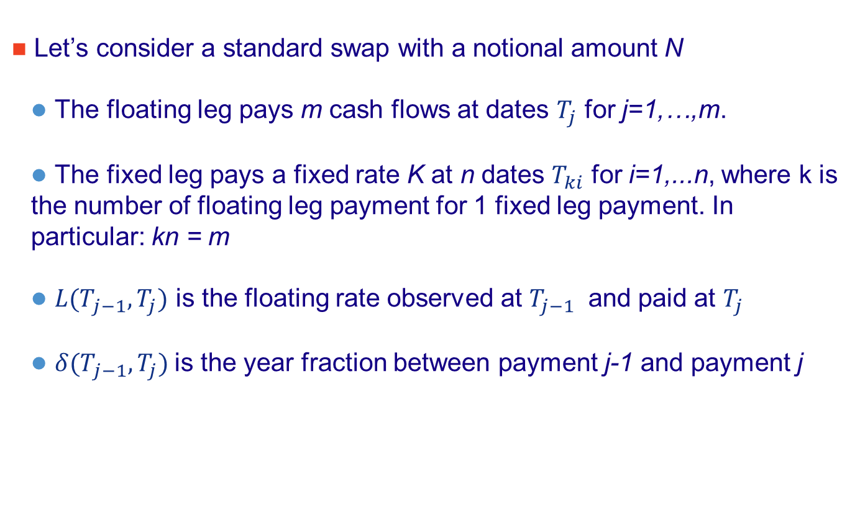
Pricing of standard swaps
Let’s consider a standard swap with a notional amount N
The floating leg pays m cash flows at dates $T_{j}$ for j=1,…,m.
The fixed leg pays a fixed rate K at n dates $T_{ki}$ for i=1,...n, where k is the number of floating leg payment for 1 fixed leg payment. In particular: kn = m
${L(T}_{j−1},T_{j})$ is the floating rate observed at $T_{j−1}$ and paid at $T_{j}$
${δ(T}_{j−1},T_{j})$is the year fraction between payment j-1 and payment j

Slide 34








Illustration
Payer Swap
$${L(T}_{0},T_{1})∗δ(T_{0},T_{1})$$
$${L(T}_{1},T_{2})∗δ(T_{1},T_{2})$$
$${L(T}_{2},T_{3})∗δ(T_{2},T_{3})$$
$${L(T}_{3},T_{4})∗δ(T_{3},T_{4})$$
$${L(T}_{m−1},T_{m})∗δ(T_{m−1},T_{m})$$
t=T0=0
t=T1
t=T2
t=T3
t=T4
t=Tm=T2n
V0 = ?
$$K∗δ(T_{0},T_{2})$$
$$K∗δ(T_{2},T_{4})$$
$$K∗δ(T_{m−2},T_{m})$$
Unknown at settlement date (t=0)
Known at settlement date (t=0)
V0 is the « price » of the swap at time 0 to be determined

Slide 35
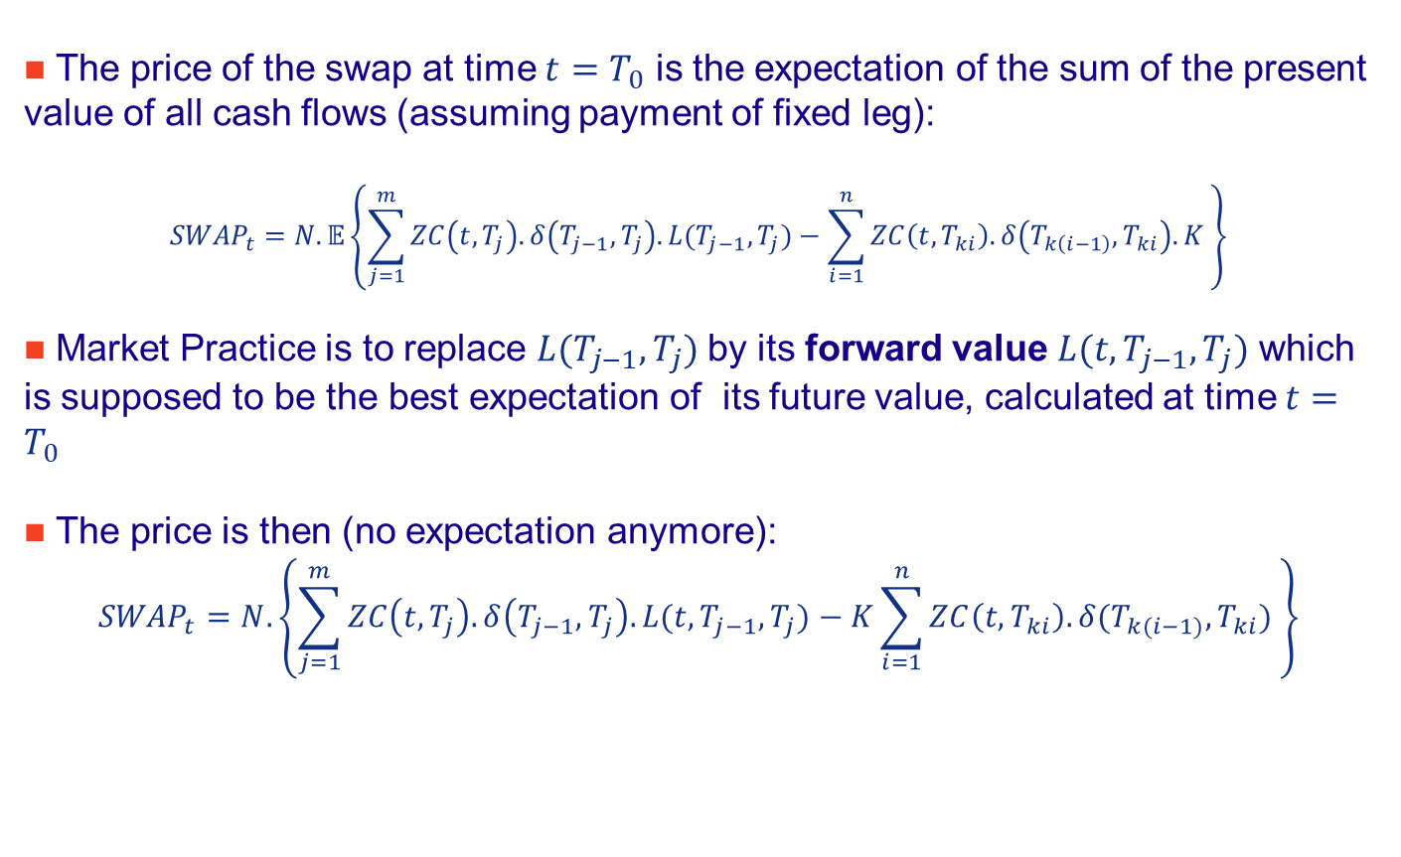
Pricing of standard swaps (2)
The price of the swap at time $t=T_{0}$ is the expectation of the sum of the present value of all cash flows (assuming payment of fixed leg):
$${SWAP}_{t}=N.𝔼\left\{\sum_{j=1}^{m}{ZC\left(t,T_{j}\right).δ\left(T_{j−1},T_{j}\right).L(T_{j−1},T_{j})}−\sum_{i=1}^{n}{ZC\left(t,T_{ki}\right).δ\left(T_{k\left(i−1\right)},T_{ki}\right).K }\right\}$$
Market Practice is to replace $L(T_{j−1},T_{j})$ by its forward value $L(t,T_{j−1},T_{j})$ which is supposed to be the best expectation of its future value, calculated at time $t=T_{0}$
The price is then (no expectation anymore):
$${SWAP}_{t}=N. \left\{\sum_{j=1}^{m}{ZC\left(t,T_{j}\right).δ\left(T_{j−1},T_{j}\right).L(t,T_{j−1},T_{j})}−K\sum_{i=1}^{n}{ZC\left(t,T_{ki}\right).δ(T_{k(i−1)},T_{ki}) }\right\}$$

Slide 36
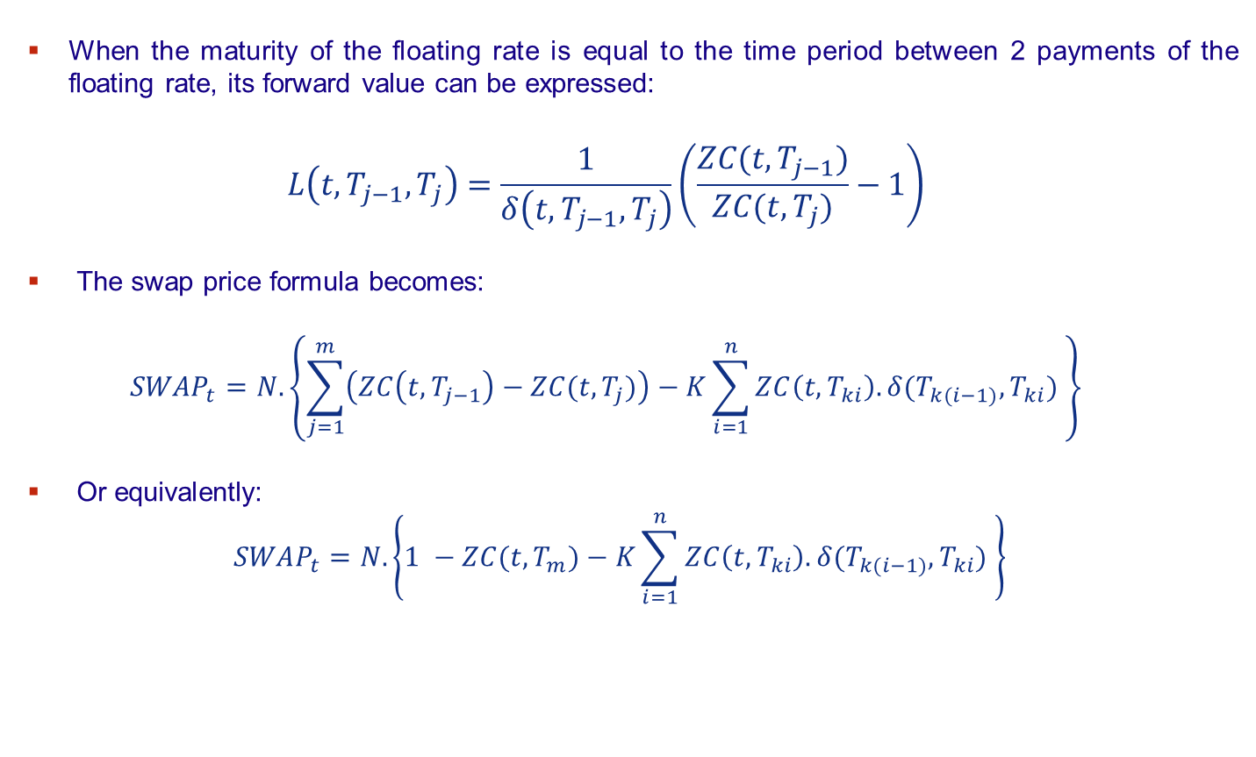
Pricing of standard swaps (3)
When the maturity of the floating rate is equal to the time period between 2 payments of the floating rate, its forward value can be expressed:
$$L\left(t,T_{j−1},T_{j}\right)=\frac{1}{δ\left(t,T_{j−1},T_{j}\right)}\left(\frac{ZC(t,T_{j−1})}{ZC(t,T_{j})}−1\right)$$
The swap price formula becomes:
$${SWAP}_{t}=N. \left\{\sum_{j=1}^{m}{\left(ZC\left(t,T_{j−1}\right)−ZC(t,T_{j})\right)}−K\sum_{i=1}^{n}{ZC\left(t,T_{ki}\right).δ(T_{k(i−1)},T_{ki}) }\right\}$$
Or equivalently:
$${SWAP}_{t}=N. \left\{1 −ZC(t,T_{m})−K\sum_{i=1}^{n}{ZC\left(t,T_{ki}\right).δ(T_{k(i−1)},T_{ki}) }\right\}$$

Slide 37
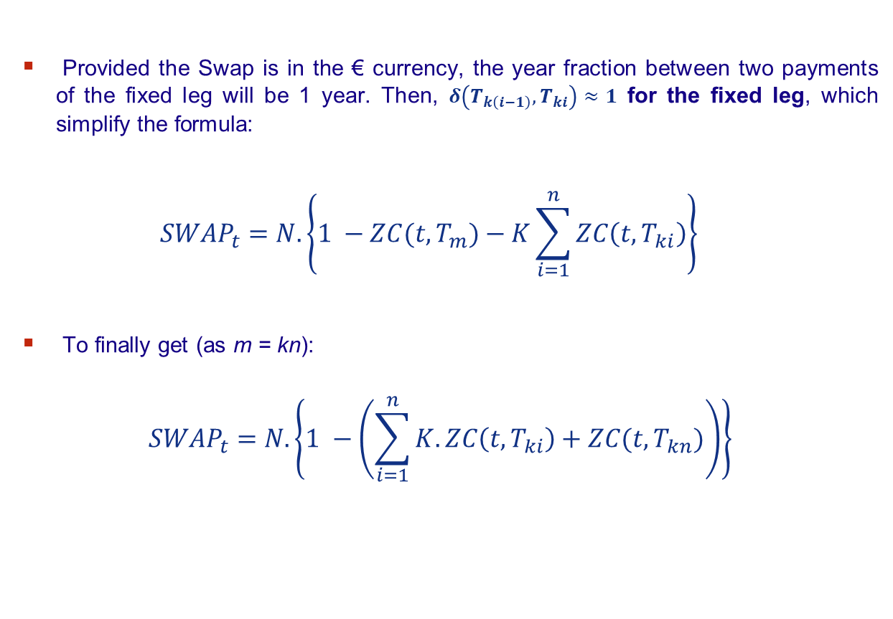
Pricing of standard swaps (4)
Provided the Swap is in the € currency, the year fraction between two payments of the fixed leg will be 1 year. Then, $δ\left(T_{k\left(i−1\right)},T_{ki}\right)≈1$ for the fixed leg, which simplify the formula:
$${SWAP}_{t}=N. \left\{1 −ZC(t,T_{m})−K\sum_{i=1}^{n}{ZC\left(t,T_{ki}\right)}\right\}$$
To finally get (as m = kn):
$${SWAP}_{t}=N. \left\{1 −\left(\sum_{i=1}^{n}{K.ZC\left(t,T_{ki}\right)+ZC(t,T_{kn})}\right)\right\}$$

Slide 38






A very simple example to understand the formula (FRA)
Payer FRA (« swap with only one cashflow »)
$${L(T}_{1},T_{2})∗δ(T_{1},T_{2})$$
Unknown at settlement date (t=0)
Known at settlement date (t=0)
t=T0=0
t=T1
t=T2
V0 = ?
$$K∗δ(T_{1},T_{2})$$
The trick is to remark that the above cashflow pattern is equivalent to:
$$1+{L(T}_{1},T_{2})∗δ(T_{1},T_{2})$$
= $ZC\left(T_{0},T_{1}\right)$
$$1$$
t=T0=0
t=T1
t=T2
V0 = $ZC\left(T_{0},T_{1}\right)−ZC\left(T_{0},T_{2}\right)∗\left(1+K∗δ(T_{1},T_{2})\right)$
1+$K∗δ(T_{1},T_{2})$
ZC(0,T2)* (1+$K∗δ(T_{1},T_{2})$)

Slide 39
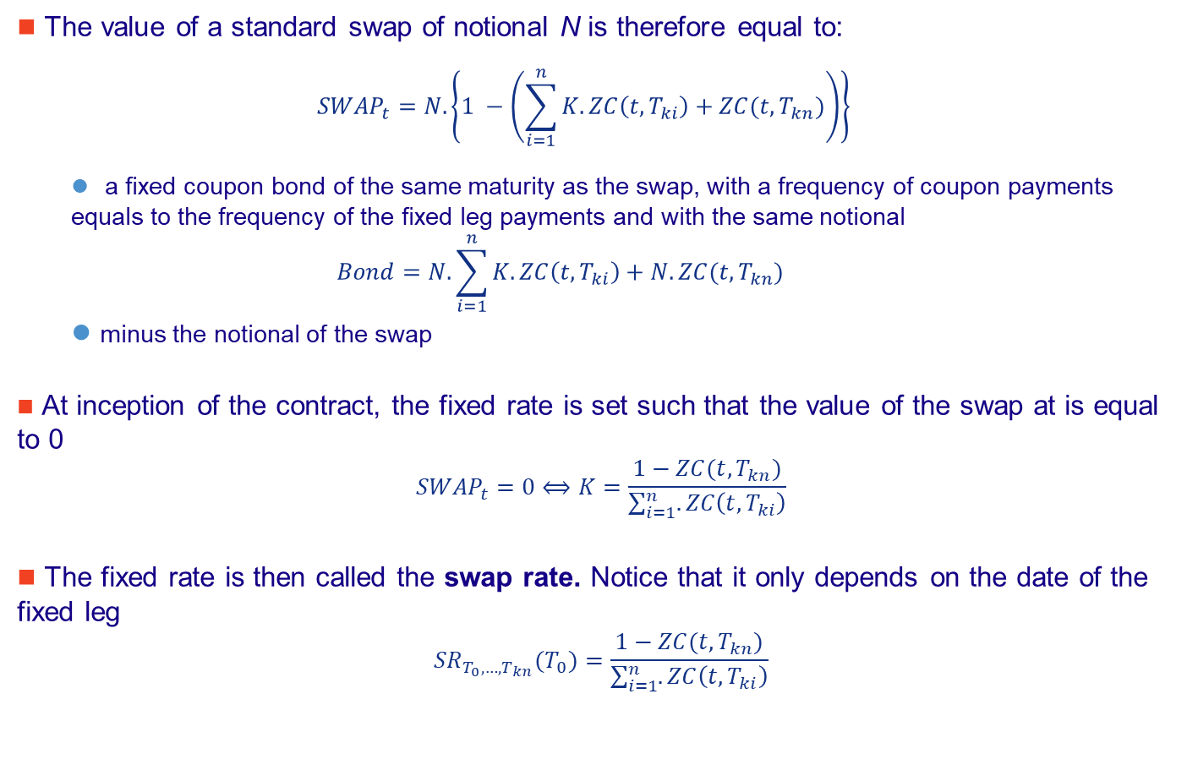
Pricing of standard swaps: Important remarks
The value of a standard swap of notional N is therefore equal to:
$${SWAP}_{t}=N. \left\{1 −\left(\sum_{i=1}^{n}{K.ZC\left(t,T_{ki}\right)+ZC(t,T_{kn})}\right)\right\}$$
a fixed coupon bond of the same maturity as the swap, with a frequency of coupon payments equals to the frequency of the fixed leg payments and with the same notional
$$Bond=N.\sum_{i=1}^{n}{K.ZC\left(t,T_{ki}\right)+N.ZC(t,T_{kn})}$$
minus the notional of the swap
At inception of the contract, the fixed rate is set such that the value of the swap at is equal to 0
$${SWAP}_{t}=0⟺K=\frac{1−ZC(t,T_{kn})}{\sum_{i=1}^{n}{.ZC\left(t,T_{ki}\right)}}$$
The fixed rate is then called the swap rate. Notice that it only depends on the date of the fixed leg
$${SR}_{T_{0},…,T_{kn}}(T_{0})=\frac{1−ZC(t,T_{kn})}{\sum_{i=1}^{n}{.ZC\left(t,T_{ki}\right)}}$$

Slide 40
Pricing of standard swaps: Example 1
Consider a receiver swap:
10 year maturity
Notional amount 1,000,000 euros
fixed rate 5%
floating rate: 6 months Euribor
Assume a flat rate curve at 5%
The price of the swap is then:
the price of a fixed 5% coupon bond of maturity 10 year with notional amount of 1,000,000. Its price is then 1,000,000 as its coupon is equal its YTM
Value of the swap is then 0
P = 1.000.000 - 1.000.000 = 0

Slide 41
Pricing of standard swaps: Example 2
What happens to the price if the interest rate curve instantaneously moves of 0,5% (parallel shift) ? Same question for +1% and a decrease of 0,5%.
1- In case of a +0,5% parallel shift, the price of the swap is then:
P = 962.312 - 1.000.000 = -37.688
2- In case of a +1% parallel shift, the price of the swap is then:
P = 926.399 - 1.000.000 = -73.601
3- In case of a -0,5% parallel shift, the price of the swap is then:
P = 1.039.564 - 1.000.000 = -39.564

Slide 42
Non-standard swaps (1)
Swaps with non constant notional:
Amortizing swaps are swaps whose notional amount decreases when time passes
Accrediting swaps are swaps whose notional amount increases when time passes
Roller coaster swaps are swaps whose notional amount can increase or decrease through time
Idea of these instruments: adjust the evolution of the notional amount to match potential evolution of notional on a debt
Notes:
Faire un petit laïus sur les « idées » de pricing de tels swaps:
Nominal déterministe
Nominal fonction du Libor
…

Slide 43
Non-standard swaps (2)
Basis swaps:
A basis swap exchanges 2 floating legs
Exchanged rates can be on different markets (swap vs. sovereign YTM) and of different maturity (Libor 3 months vs. Libor 1year)
CMS and CMT swaps:
Swap of 2 floating legs: a Libor (or Euribor) rate vs. a swap rate of constant maturity
Swap of 2 floating legs: a Libor (or Euribor) rate vs. the YTM of a sovereign bond of constant maturity
Examples:
3 months Libor vs. 10yr swap rate
3 months Euribor vs. YTM of a 10yr sovereign bond

Slide 44
Non-standard swaps (3)
Forward Start Swap:
Swap do not start at inception of the contract but later at a given future date
Curve Swap:
Swap of 2 floating leg of 2 different maturities on the same IR curve
Example:
6 month T-Bill vs. 5yr CMT
Zero-Coupon swap:
Swap of a fixed or floating leg with several cashflows vs. a fixed rate with only one cash flow (at maturity)
Example:
4yr ZC swap than exchange annually a 7% fixed rate vs. a single 8% coupon in 4years
Notes:
Penser aux méthodes de pricing…

Slide 45
Extracting ZC

Slide 46
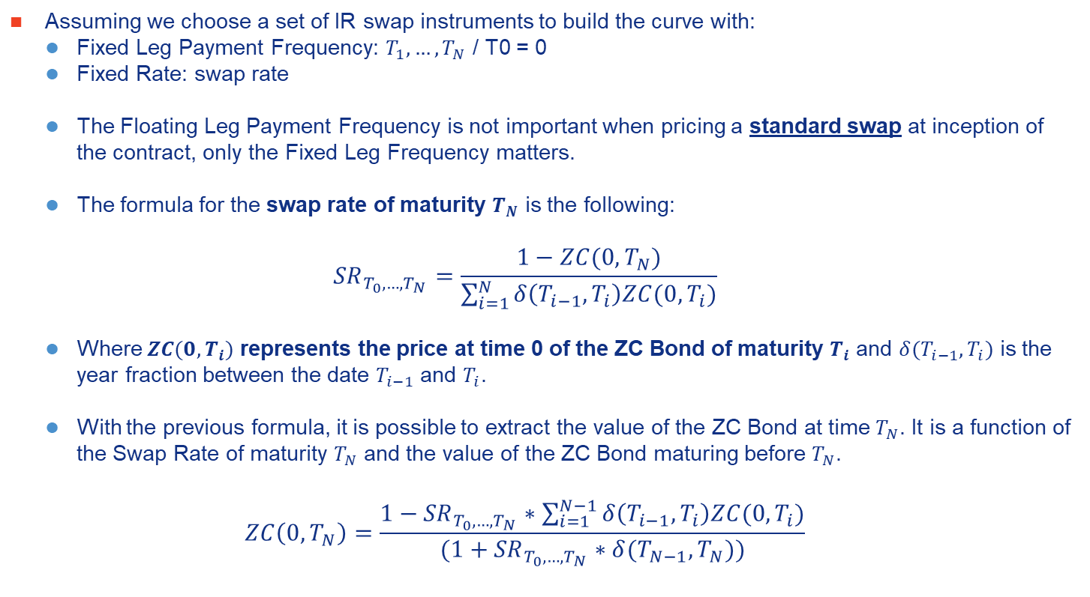
Extracting ZC from a Swap Curve The stripping method
Assuming we choose a set of IR swap instruments to build the curve with:
Fixed Leg Payment Frequency: $T_{1},…,T_{N}$ / T0 = 0
Fixed Rate: swap rate
The Floating Leg Payment Frequency is not important when pricing a standard swap at inception of the contract, only the Fixed Leg Frequency matters.
The formula for the swap rate of maturity $T_{N}$ is the following:
$${SR}_{T_{0},…,T_{N}}=\frac{1−ZC(0,T_{N})}{\sum_{i=1}^{N}{δ\left(T_{i−1},T_{i}\right)ZC(0,T_{i})}}$$
Where $ZC(0,T_{i})$ represents the price at time 0 of the ZC Bond of maturity $T_{i}$ and $δ(T_{i−1},T_{i})$ is the year fraction between the date $T_{i−1}$ and $T_{i}$.
With the previous formula, it is possible to extract the value of the ZC Bond at time $T_{N}$. It is a function of the Swap Rate of maturity $T_{N}$ and the value of the ZC Bond maturing before $T_{N}$.
$$ZC\left(0,T_{N}\right)=\frac{1−{SR}_{T_{0},…,T_{N}}∗\sum_{i=1}^{N−1}{δ\left(T_{i−1},T_{i}\right)ZC(0,T_{i})}}{(1+{SR}_{T_{0},…,T_{N}}∗δ(T_{N−1},T_{N}))}$$

Slide 47
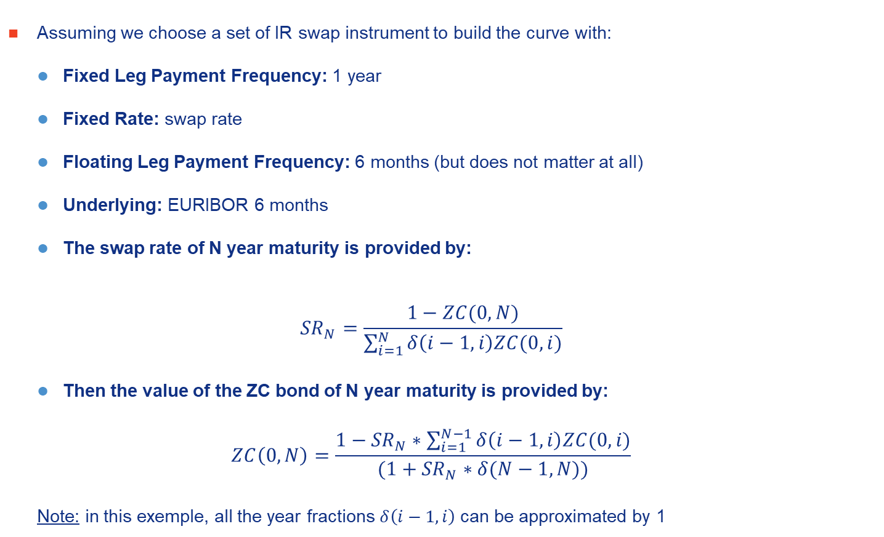
Extracting ZC from a Swap Curve The stripping method
Assuming we choose a set of IR swap instrument to build the curve with:
Fixed Leg Payment Frequency: 1 year
Fixed Rate: swap rate
Floating Leg Payment Frequency: 6 months (but does not matter at all)
Underlying: EURIBOR 6 months
The swap rate of N year maturity is provided by:
$${SR}_{N}=\frac{1−ZC(0,N)}{\sum_{i=1}^{N}{δ\left(i−1,i\right)ZC(0,i)}}$$
Then the value of the ZC bond of N year maturity is provided by:
$$ZC\left(0,N\right)=\frac{1−{SR}_{N}∗\sum_{i=1}^{N−1}{δ\left(i−1,i\right)ZC(0,i)}}{(1+{SR}_{N}∗δ(N−1,N))}$$
Note: in this exemple, all the year fractions $δ\left(i−1,i\right)$ can be approximated by 1

Slide 48
Pricing of a simple product

Slide 49
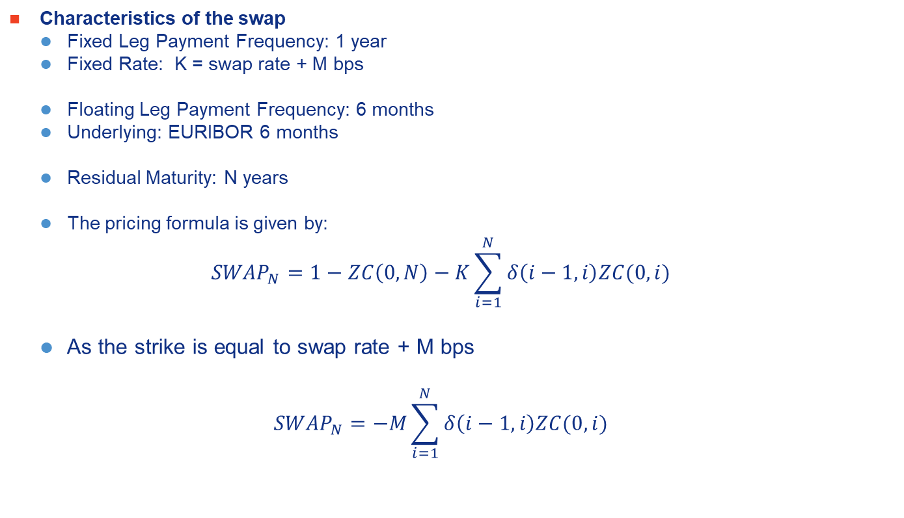
Example Pricing of a IR Payer Swap at Swap Rate + M bps
Characteristics of the swap
Fixed Leg Payment Frequency: 1 year
Fixed Rate: K = swap rate + M bps
Floating Leg Payment Frequency: 6 months
Underlying: EURIBOR 6 months
Residual Maturity: N years
The pricing formula is given by:
$${SWAP}_{N}=1−ZC\left(0,N\right)−K\sum_{i=1}^{N}{δ\left(i−1,i\right)ZC(0,i)}$$
As the strike is equal to swap rate + M bps
$${SWAP}_{N}=−M\sum_{i=1}^{N}{δ\left(i−1,i\right)ZC(0,i)}$$

Slide 50
Pricing of complex products
Using Model & Closed Form Formulas

Slide 51
Swaptions
Black Model for Swap Rates

Slide 52
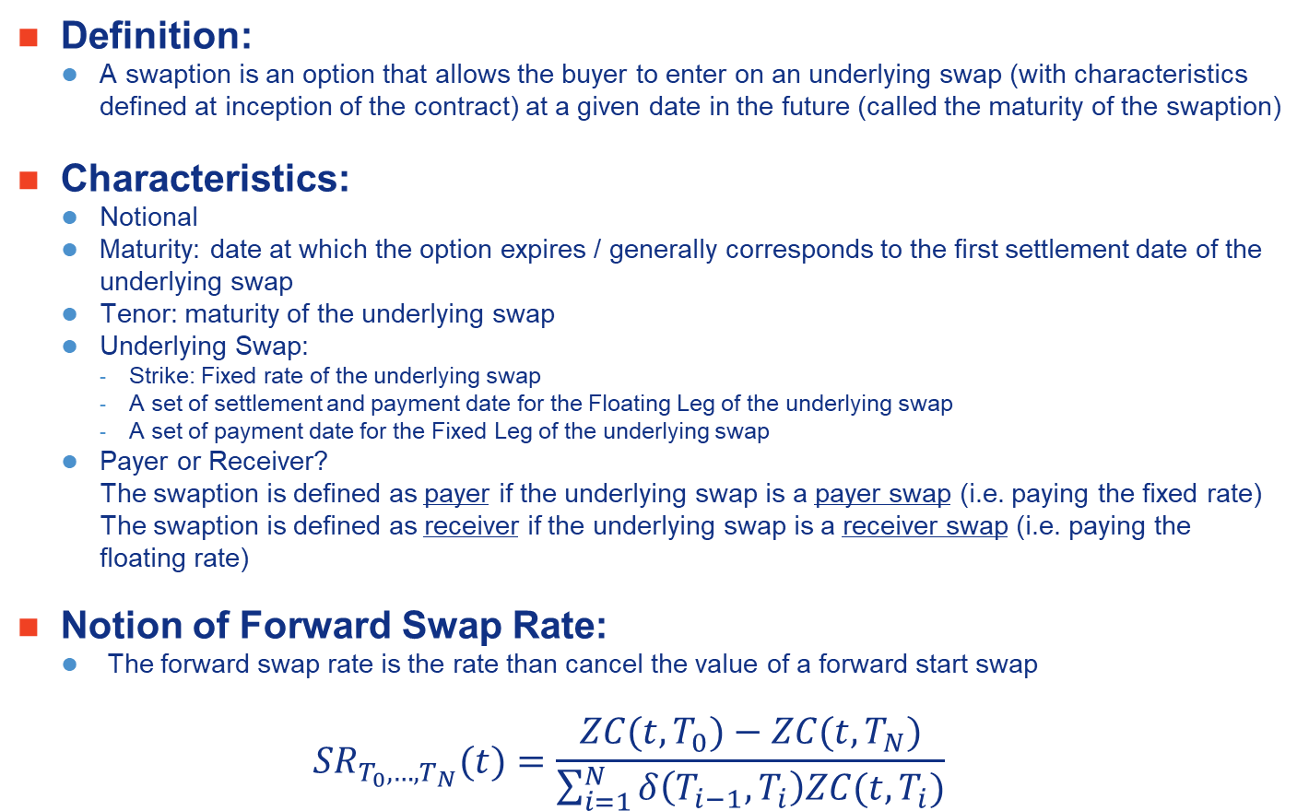
Example Pricing of Swaption
Definition:
A swaption is an option that allows the buyer to enter on an underlying swap (with characteristics defined at inception of the contract) at a given date in the future (called the maturity of the swaption)
Characteristics:
Notional
Maturity: date at which the option expires / generally corresponds to the first settlement date of the underlying swap
Tenor: maturity of the underlying swap
Underlying Swap:
Strike: Fixed rate of the underlying swap
A set of settlement and payment date for the Floating Leg of the underlying swap
A set of payment date for the Fixed Leg of the underlying swap
Payer or Receiver?
The swaption is defined as payer if the underlying swap is a payer swap (i.e. paying the fixed rate)
The swaption is defined as receiver if the underlying swap is a receiver swap (i.e. paying the floating rate)
Notion of Forward Swap Rate:
The forward swap rate is the rate than cancel the value of a forward start swap
$${SR}_{T_{0},…,T_{N}}(t)=\frac{ZC(t,T_{0})−ZC(t,T_{N})}{\sum_{i=1}^{N}{δ\left(T_{i−1},T_{i}\right)ZC(t,T_{i})}}$$

Slide 53
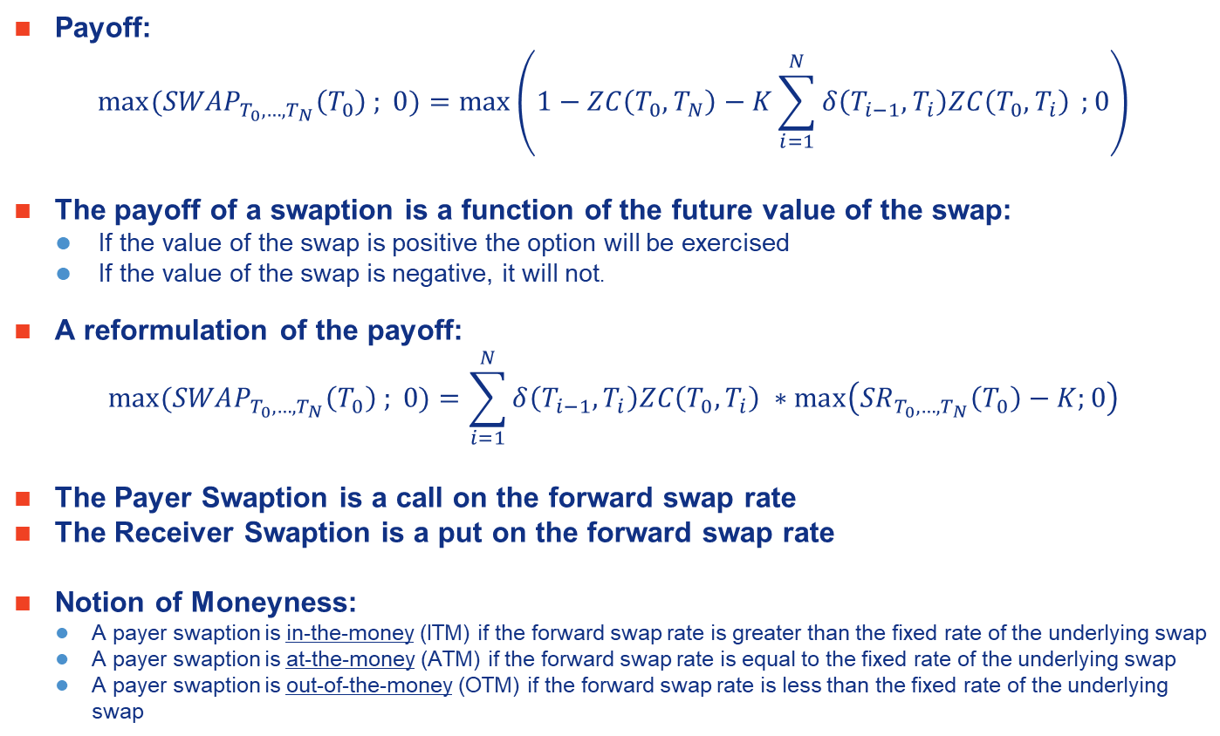
Example Pricing of Swaption
Payoff:
$${max⁡(SWAP}_{T_{0},…,T_{N}}\left(T_{0}\right) ; 0)=max⁡\left(1−ZC\left(T_{0},T_{N}\right)−K\sum_{i=1}^{N}{δ\left(T_{i−1},T_{i}\right)ZC\left(T_{0},T_{i}\right)} ;0\right)$$
The payoff of a swaption is a function of the future value of the swap:
If the value of the swap is positive the option will be exercised
If the value of the swap is negative, it will not.
A reformulation of the payoff:
$${max⁡(SWAP}_{T_{0},…,T_{N}}\left(T_{0}\right) ; 0)=\sum_{i=1}^{N}{δ\left(T_{i−1},T_{i}\right)ZC\left(T_{0},T_{i}\right)} ∗\max\left({SR}_{T_{0},…,T_{N}}\left(T_{0}\right)−K;0\right)$$
The Payer Swaption is a call on the forward swap rate
The Receiver Swaption is a put on the forward swap rate
Notion of Moneyness:
A payer swaption is in-the-money (ITM) if the forward swap rate is greater than the fixed rate of the underlying swap
A payer swaption is at-the-money (ATM) if the forward swap rate is equal to the fixed rate of the underlying swap
A payer swaption is out-of-the-money (OTM) if the forward swap rate is less than the fixed rate of the underlying swap

Slide 54
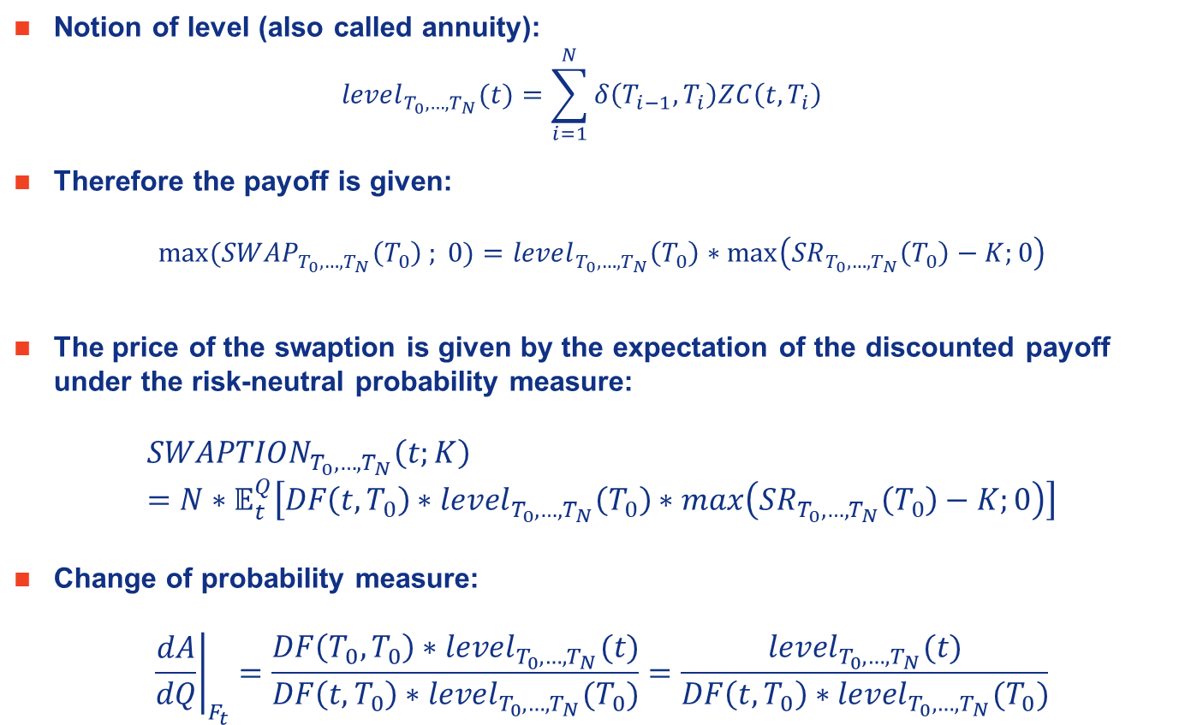
Example Pricing of Swaption
Notion of level (also called annuity):
$${level}_{T_{0},…,T_{N}}(t)=\sum_{i=1}^{N}{δ\left(T_{i−1},T_{i}\right)ZC\left(t,T_{i}\right)}$$
Therefore the payoff is given:
$$max⁡({SWAP}_{T_{0},…,T_{N}}\left(T_{0}\right) ; 0)={level}_{T_{0},…,T_{N}}\left(T_{0}\right)∗\max\left({SR}_{T_{0},…,T_{N}}\left(T_{0}\right)−K;0\right)$$
The price of the swaption is given by the expectation of the discounted payoff under the risk-neutral probability measure:
$${SWAPTION}_{T_{0},…,T_{N}}\left(t;K\right)=N∗𝔼_{t}^{Q}\left[DF\left(t,T_{0}\right)∗{level}_{T_{0},…,T_{N}}\left(T_{0}\right)∗\max\left({SR}_{T_{0},…,T_{N}}\left(T_{0}\right)−K;0\right)\right]$$
Change of probability measure:
$${\left.\frac{dA}{dQ}\right|}_{F_{t}}=\frac{DF\left(T_{0},T_{0}\right)∗{level}_{T_{0},…,T_{N}}(t)}{DF\left(t,T_{0}\right)∗{level}_{T_{0},…,T_{N}}(T_{0})}=\frac{{level}_{T_{0},…,T_{N}}(t)}{DF\left(t,T_{0}\right)∗{level}_{T_{0},…,T_{N}}(T_{0})}$$

Slide 55
Example Pricing of Swaption
The formula is then given by:
$${SWAPTION}_{T_{0},…,T_{N}}\left(t\right)=N∗{level}_{T_{0},…,T_{N}}\left(t\right)∗E_{t}^{A}\left[\max\left({SR}_{T_{0},…,T_{N}}\left(T_{0}\right)−K;0\right)\right]$$
By assuming the following model (or equivalently a diffusion) for the forward swap rate under the probability $A$:
$$\frac{d{SR}_{T_{0},…,T_{N}}\left(t\right)}{{SR}_{T_{0},…,T_{N}}\left(t\right)}=σ_{T_{0},…,T_{N}}{dW}_{t}^{A}$$
The price of the swaption can be computed with a Black formula (as it is Market Practice):
$${SWAPTION}_{T_{0},…,T_{N}}\left(t,{SR}_{T_{0},…,T_{N}}\left(t\right);K;σ_{T_{0},…,T_{N}}\right)=N∗{level}_{T_{0},…,T_{N}}\left(t\right)∗\left({SR}_{T_{0},…,T_{N}}\left(t\right)∗Φ\left(d_{1}\right)−K∗Φ\left(d_{2}\right)\right)$$
With:
$d_{1}=\frac{ln\left(\frac{{SR}_{T_{0},…,T_{N}}\left(t\right)}{K}\right)+\frac{1}{2}σ_{T_{0},…,T_{N}}^{2}T_{0}}{σ_{T_{0},…,T_{N}}\sqrt{T_{0}}}$ and $d_{2}=\frac{ln\left(\frac{{SR}_{T_{0},…,T_{N}}\left(t\right)}{K}\right)−\frac{1}{2}σ_{T_{0},…,T_{N}}^{2}T_{0}}{σ_{T_{0},…,T_{N}}\sqrt{T_{0}}}$

Slide 56
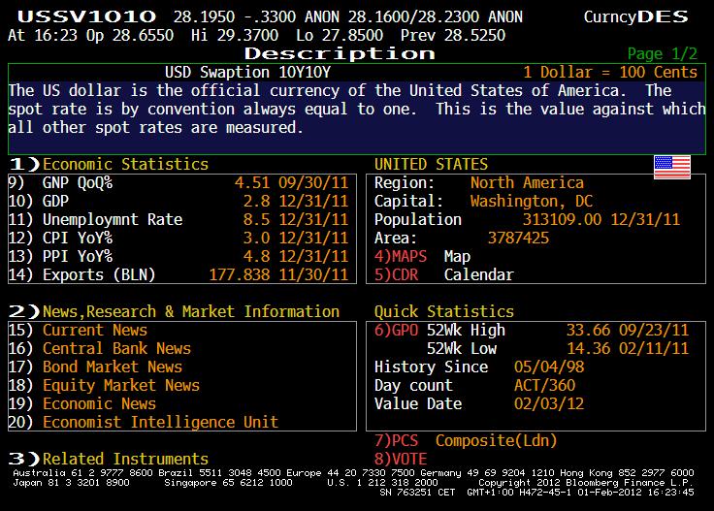
Swaptions – Quotations (US) Ex : swaption 10 mat. x10 tenor

Slide 57
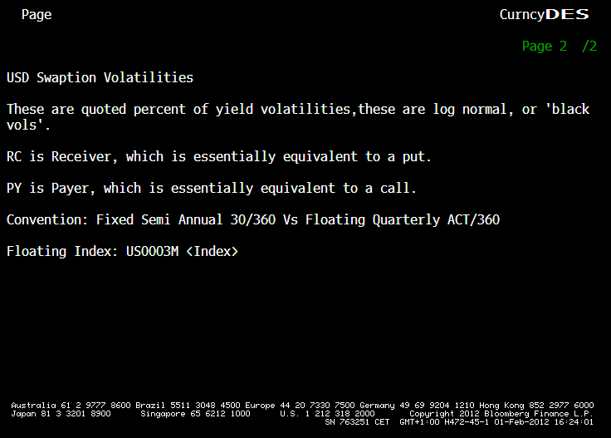
Swaptions – Quotations (US) Ex : swaption 10 mat. x10 tenor

Slide 58
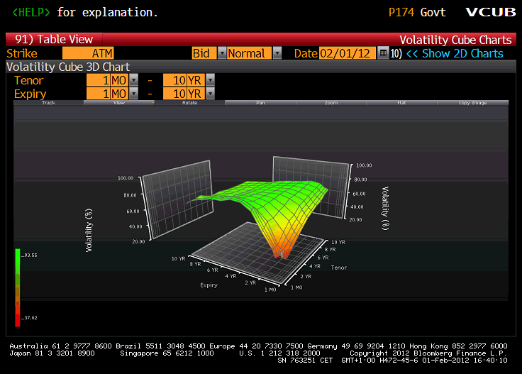
Swaptions – Quotations (US) Ex : Implied Vol. Surface (ATM)

Slide 59
In-Arrears Swaps
Black Model for Libor Rates

Slide 60
In-Arrears Swap
A swap «in-arrears» pays the Libor rate at its date of observation (and not at its maturity)
As this payment date is not natural, the formula used for standard swap is not applicable anymore
Under risk neutral probability:
$${IASWAP}_{T_{0},…,T_{N}}\left(t;K\right)=N∗𝔼_{t}^{Q}\left[\sum_{i=1}^{N}{DF\left(t,T_{i}\right)∗δ\left(T_{i},T_{i+1}\right)∗\left(L(T_{i},T_{i},T_{i+1})−K\right)}\right]$$
With:
$𝔼_{t}^{Q}$ denotes the risk-neutral expectation conditionally to time t
$DF\left(t,T_{i}\right)$ is the discount factor b/w t and $T_{i}$
K is the paid fixed rate
$L(T_{i},T_{i},T_{i+1})$ is the Libor rate which starts at $T_{i}$ for maturity $T_{i+1}$ (paid immediately at time $T_{i}$ in this example)

Slide 61
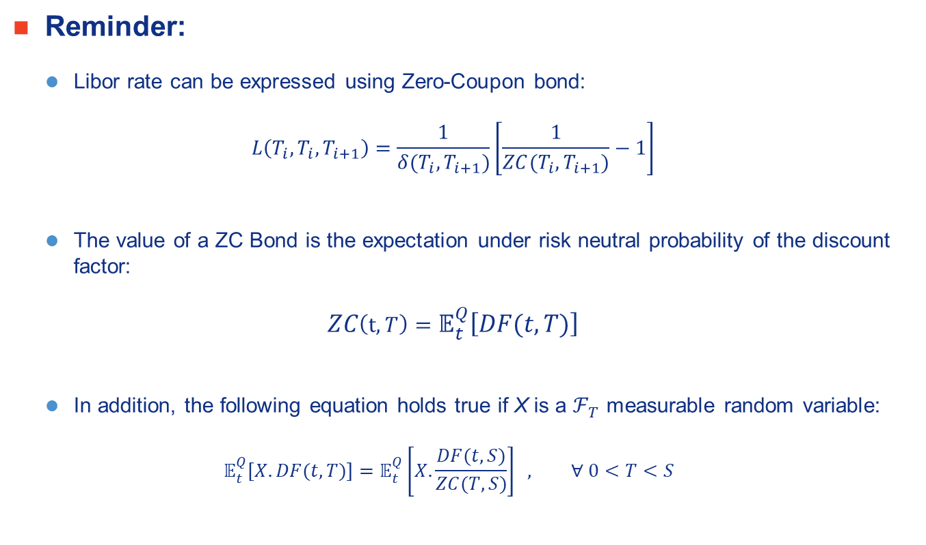
In-Arrears Swaps (2)
Reminder:
Libor rate can be expressed using Zero-Coupon bond:
$$L\left(T_{i},T_{i},T_{i+1}\right)=\frac{1}{δ(T_{i},T_{i+1})}\left[\frac{1}{ZC(T_{i},T_{i+1})}−1\right]$$
The value of a ZC Bond is the expectation under risk neutral probability of the discount factor:
$$ZC\left(t, T\right)=𝔼_{t}^{Q}\left[DF(t,T)\right]$$
In addition, the following equation holds true if X is a $ℱ_{T}$ measurable random variable:
$$𝔼_{t}^{Q}\left[X.DF(t,T)\right]=𝔼_{t}^{Q}\left[X. \frac{DF(t,S)}{ZC(T,S)}\right] , ∀ 0<T<S$$

Slide 62
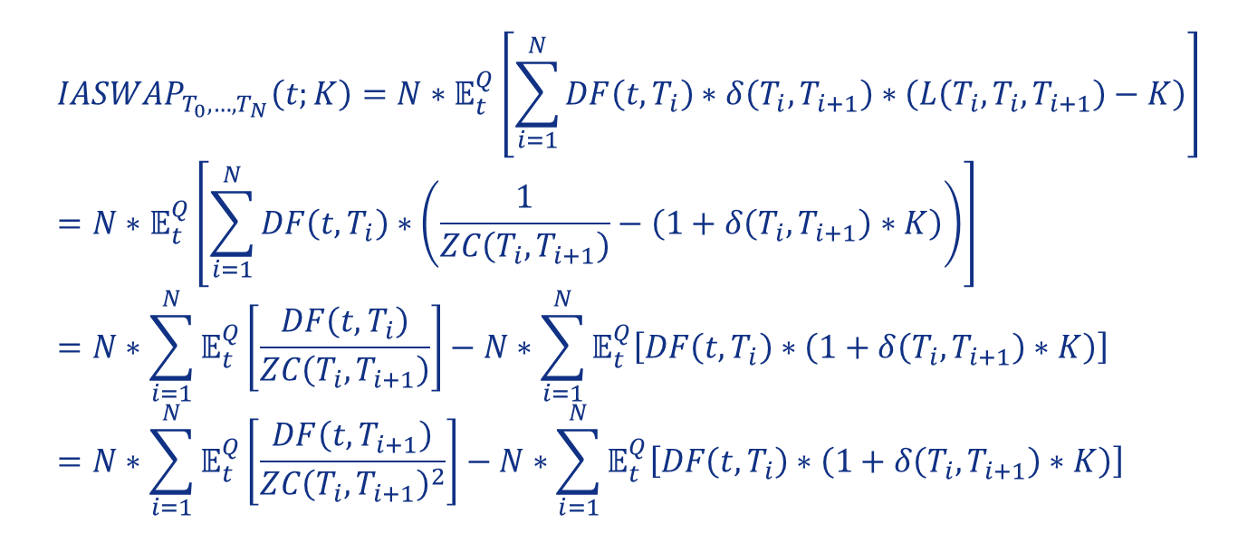
In-Arrears Swaps (3)
$${IASWAP}_{T_{0},…,T_{N}}\left(t;K\right)=N∗𝔼_{t}^{Q}\left[\sum_{i=1}^{N}{DF\left(t,T_{i}\right)∗δ\left(T_{i},T_{i+1}\right)∗\left(L\left(T_{i},T_{i},T_{i+1}\right)−K\right)}\right]=N∗𝔼_{t}^{Q}\left[\sum_{i=1}^{N}{DF\left(t,T_{i}\right)∗\left(\frac{1}{ZC\left(T_{i},T_{i+1}\right)}−\left(1+δ\left(T_{i},T_{i+1}\right)∗K\right)\right)}\right]=N∗\sum_{i=1}^{N}{𝔼_{t}^{Q}\left[\frac{DF\left(t,T_{i}\right)}{ZC\left(T_{i},T_{i+1}\right)}\right]}−N∗\sum_{i=1}^{N}{𝔼_{t}^{Q}\left[DF\left(t,T_{i}\right)∗\left(1+δ\left(T_{i},T_{i+1}\right)∗K\right)\right]}=N∗\sum_{i=1}^{N}{𝔼_{t}^{Q}\left[\frac{DF\left(t,T_{i+1}\right)}{{ZC\left(T_{i},T_{i+1}\right)}^{2}}\right]}−N∗\sum_{i=1}^{N}{𝔼_{t}^{Q}\left[DF\left(t,T_{i}\right)∗\left(1+δ\left(T_{i},T_{i+1}\right)∗K\right)\right]}$$
We changed the date of the discount factor!
This term is easy to price

Slide 63
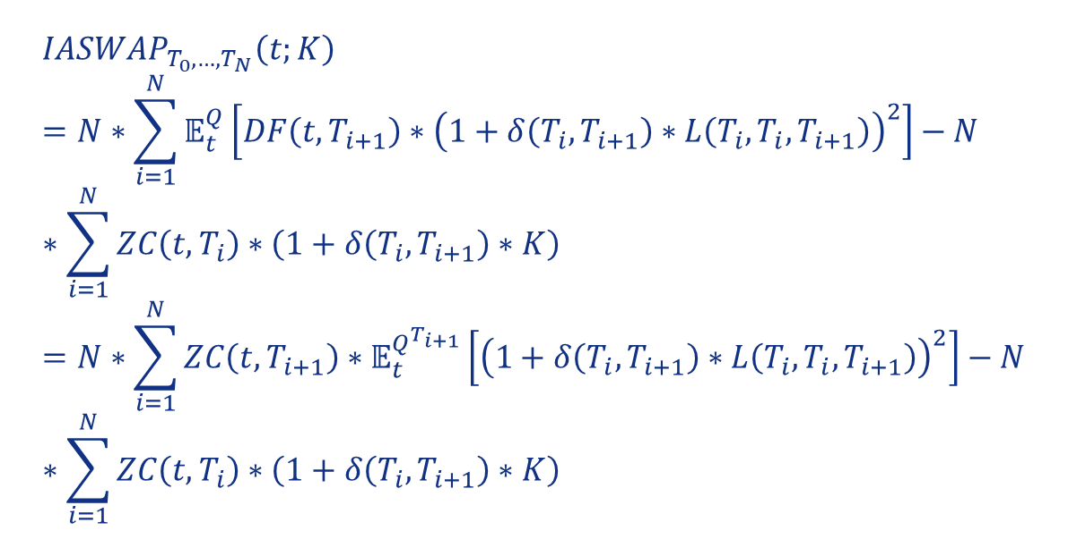
In-Arrears Swaps (4)
$${IASWAP}_{T_{0},…,T_{N}}\left(t;K\right)=N∗\sum_{i=1}^{N}{𝔼_{t}^{Q}\left[DF\left(t,T_{i+1}\right){∗\left(1+δ\left(T_{i},T_{i+1}\right)∗L\left(T_{i},T_{i},T_{i+1}\right)\right)}^{2}\right]}−N∗\sum_{i=1}^{N}{ZC\left(t,T_{i}\right)∗\left(1+δ\left(T_{i},T_{i+1}\right)∗K\right)}=N∗\sum_{i=1}^{N}{ZC\left(t,T_{i+1}\right)∗𝔼_{t}^{Q^{T_{i+1}}}\left[{\left(1+δ\left(T_{i},T_{i+1}\right)∗L\left(T_{i},T_{i},T_{i+1}\right)\right)}^{2}\right]}−N∗\sum_{i=1}^{N}{ZC\left(t,T_{i}\right)∗\left(1+δ\left(T_{i},T_{i+1}\right)∗K\right)}$$
Libor rate is martingale under this probability

Slide 64
In-Arrears Swaps (5)
We will use a Black model for forward Libor rate:
$$\frac{dL\left(t,T_{i},T_{i+1}\right)}{L\left(t,T_{i},T_{i+1}\right)}=σ_{T_{i}}.dW_{t}^{T_{i+1}}$$
This Stochastical Differential Equation has the following explicit formula:
$$L\left(T_{i},T_{i},T_{i+1}\right)=L\left(t,T_{i},T_{i+1}\right)∗exp\left(−\frac{1}{2}.σ_{T_{i}}^{2}.(T_{i}−t)+σ_{T_{i}}.(W_{T_{i}}^{T_{i+1}}−W_{t}^{T_{i+1}})\right)$$

Slide 65
In-Arrears Swaps (6)
Computation of the following expectation:
$$𝔼_{t}^{Q^{T_{i+1}}}\left[{\left(1+δ\left(T_{i},T_{i+1}\right)∗L\left(T_{i},T_{i},T_{i+1}\right)\right)}^{2}\right]=1+2∗δ\left(T_{i},T_{i+1}\right)∗𝔼_{t}^{Q^{T_{i+1}}}\left[L\left(T_{i},T_{i},T_{i+1}\right)\right]+{δ\left(T_{i},T_{i+1}\right)}^{2}.𝔼_{t}^{Q^{T_{i+1}}}\left[{L\left(T_{i},T_{i},T_{i+1}\right)}^{2}\right]$$
Using Laplace transforms:
$$𝔼_{t}^{Q^{T_{i+1}}}\left[L\left(T_{i},T_{i},T_{i+1}\right)\right]=L\left(t,T_{i},T_{i+1}\right)$$
$$𝔼_{t}^{Q^{T_{i+1}}}\left[{L\left(T_{i},T_{i},T_{i+1}\right)}^{2}\right]={L\left(t,T_{i},T_{i+1}\right)}^{2}∗exp\left(σ_{T_{i}}^{2}.(T_{i}−t)\right)$$

Slide 66
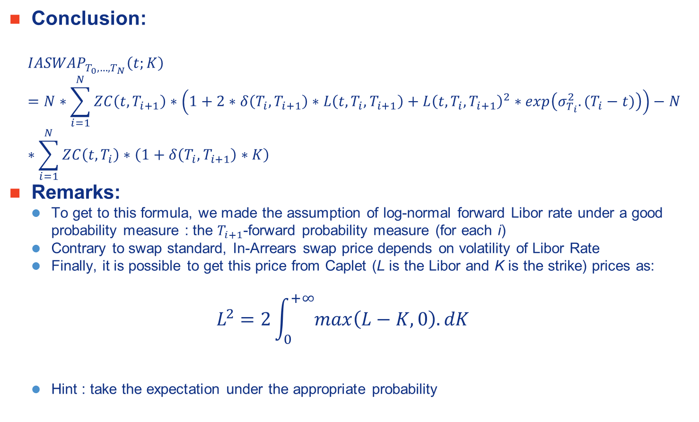
In-Arrears Swaps (7)
Conclusion:
$${IASWAP}_{T_{0},…,T_{N}}\left(t;K\right)=N∗\sum_{i=1}^{N}{ZC\left(t,T_{i+1}\right)∗\left(1+2∗δ\left(T_{i},T_{i+1}\right)∗L\left(t,T_{i},T_{i+1}\right)+{L\left(t,T_{i},T_{i+1}\right)}^{2}∗exp\left(σ_{T_{i}}^{2}.(T_{i}−t)\right)\right)}−N∗\sum_{i=1}^{N}{ZC\left(t,T_{i}\right)∗\left(1+δ\left(T_{i},T_{i+1}\right)∗K\right)}$$
Remarks:
To get to this formula, we made the assumption of log-normal forward Libor rate under a good probability measure : the $T_{i+1}$-forward probability measure (for each i)
Contrary to swap standard, In-Arrears swap price depends on volatility of Libor Rate
Finally, it is possible to get this price from Caplet (L is the Libor and K is the strike) prices as:
$$L^{2}=2\int_{0}^{+∞}{max\left(L−K,0\right).dK}$$
Hint : take the expectation under the appropriate probability

Slide 67
Example of short rate model
Vasicek Model

Slide 68
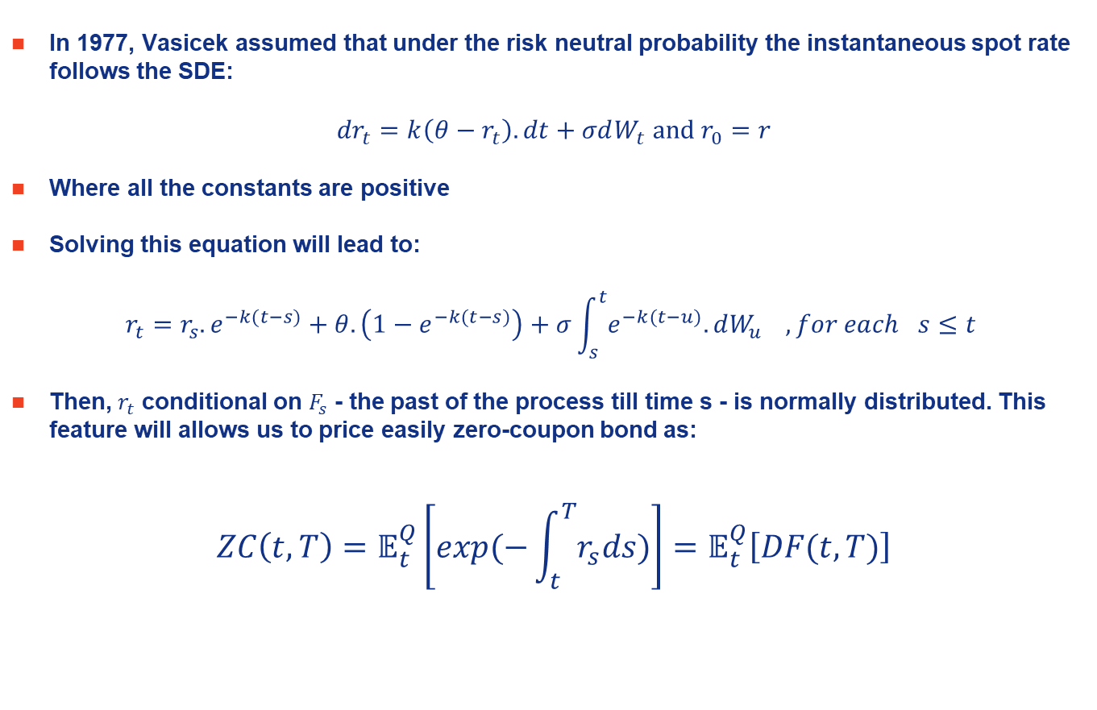
Vasicek Interest Rate model - 1
In 1977, Vasicek assumed that under the risk neutral probability the instantaneous spot rate follows the SDE:
$${dr}_{t}=k\left(θ−r_{t}\right).dt+σdW_{t} and r_{0}=r$$
Where all the constants are positive
Solving this equation will lead to:
$$r_{t}=r_{s}.e^{−k(t−s)}+θ.\left(1−e^{−k(t−s)}\right)+σ\int_{s}^{t}{e^{−k(t−u)}.dW_{u}} , for each s≤t$$
Then, $r_{t}$ conditional on $F_{s}$ - the past of the process till time s - is normally distributed. This feature will allows us to price easily zero-coupon bond as:
$$ZC\left(t,T\right)=𝔼_{t}^{Q}\left[exp⁡(−\int_{t}^{T}{r_{s}ds})\right]=𝔼_{t}^{Q}\left[DF(t,T)\right]$$

Slide 69
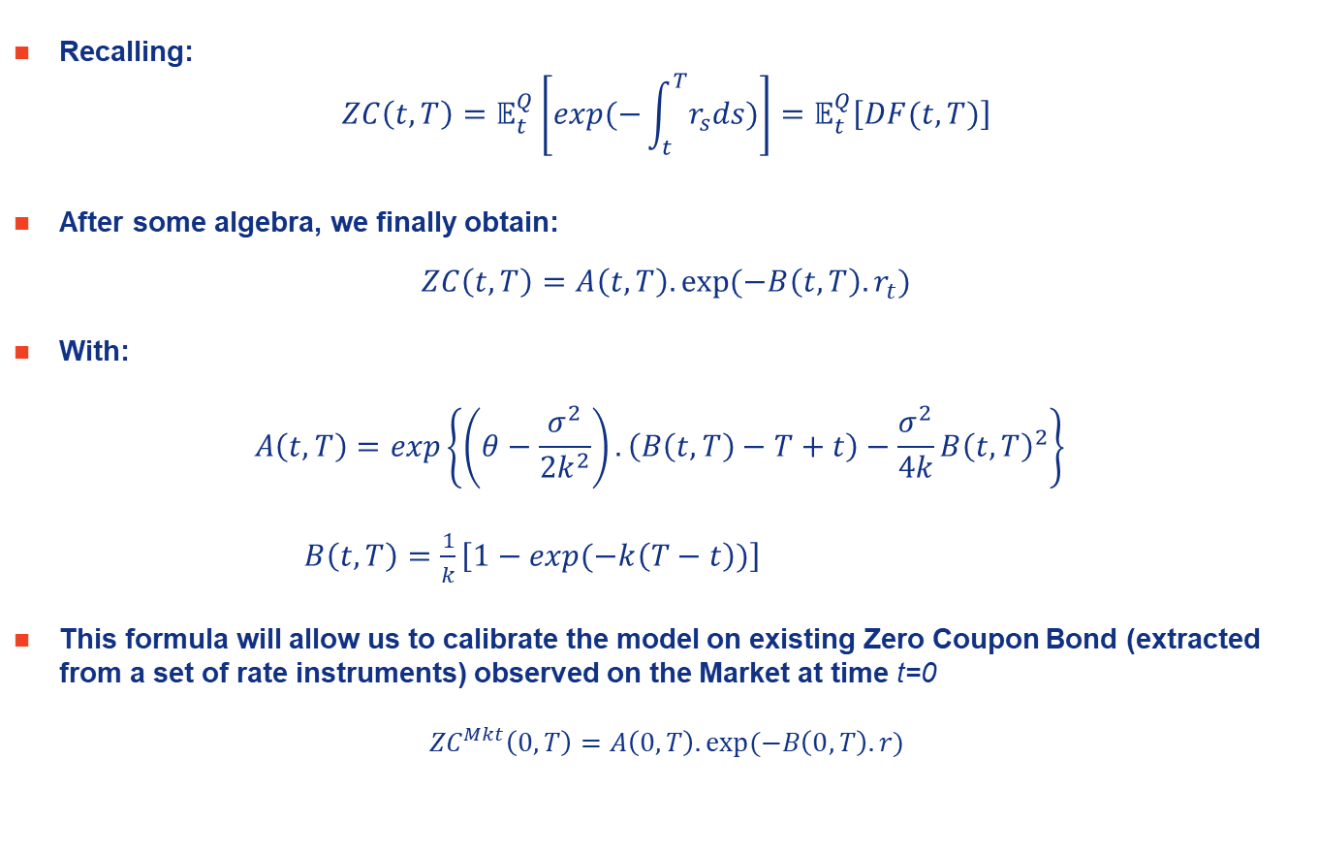
Vasicek Interest Rate model - 2
Recalling:
$$ZC\left(t,T\right)=𝔼_{t}^{Q}\left[exp⁡(−\int_{t}^{T}{r_{s}ds})\right]=𝔼_{t}^{Q}\left[DF(t,T)\right]$$
After some algebra, we finally obtain:
$$ZC\left(t,T\right)=A\left(t,T\right).exp⁡(−B\left(t,T\right).r_{t})$$
With:
$$A\left(t,T\right)=exp\left\{\left(θ−\frac{σ^{2}}{2k^{2}}\right).\left(B\left(t,T\right)−T+t\right)−\frac{σ^{2}}{4k}{B\left(t,T\right)}^{2}\right\}⁡$$
$B\left(t,T\right)=\frac{1}{k}\left[1−exp⁡(−k\left(T−t\right))\right]$
This formula will allow us to calibrate the model on existing Zero Coupon Bond (extracted from a set of rate instruments) observed on the Market at time t=0
$${ZC}^{Mkt}\left(0,T\right)=A\left(0,T\right).exp⁡(−B\left(0,T\right).r)$$

Slide 70
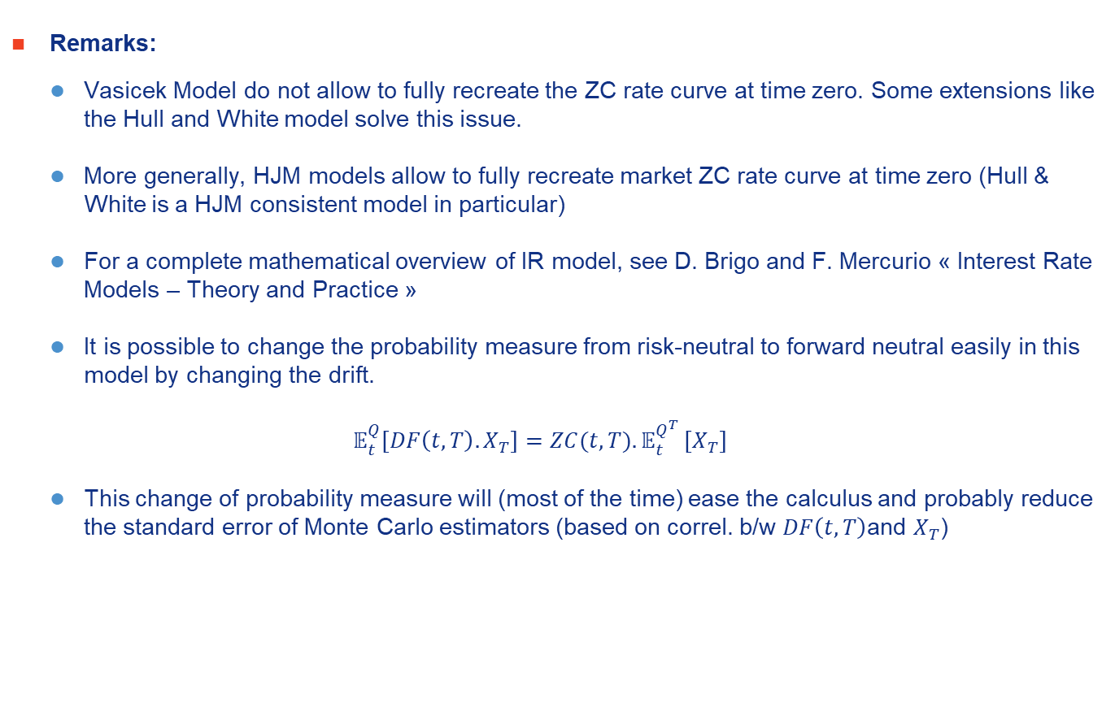
Vasicek Interest Rate model - 3
Remarks:
Vasicek Model do not allow to fully recreate the ZC rate curve at time zero. Some extensions like the Hull and White model solve this issue.
More generally, HJM models allow to fully recreate market ZC rate curve at time zero (Hull & White is a HJM consistent model in particular)
For a complete mathematical overview of IR model, see D. Brigo and F. Mercurio « Interest Rate Models – Theory and Practice »
It is possible to change the probability measure from risk-neutral to forward neutral easily in this model by changing the drift.
$$𝔼_{t}^{Q}\left[DF\left(t,T\right).X_{T}\right]=ZC(t,T){.𝔼}_{t}^{Q^{T}}\left[X_{T}\right]$$
This change of probability measure will (most of the time) ease the calculus and probably reduce the standard error of Monte Carlo estimators (based on correl. b/w $DF\left(t,T\right)$and $X_{T}$)

